Slide 1
Predictive Analysis of Cryptocurrency Price
Nilabja Bhattacharya - 2018201036
Ajay Jadhav - 2018201095
Nitish Dwivedi - 2018201068
Ravi Hooda - 2018201041

Slide 2
Introduction
Data Analysis
Neural Network for Bitcoin price prediction
Twitter sentiment analysis for Bitcoin price prediction
Observations
Conclusion

Slide 3
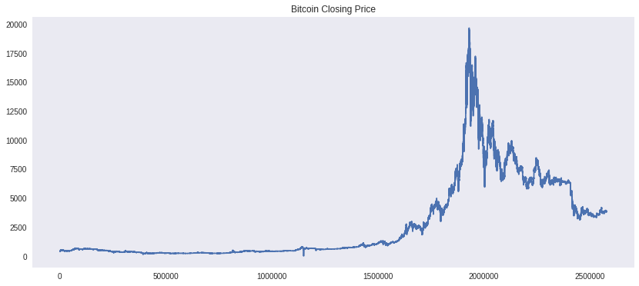
Data Analysis

Slide 4
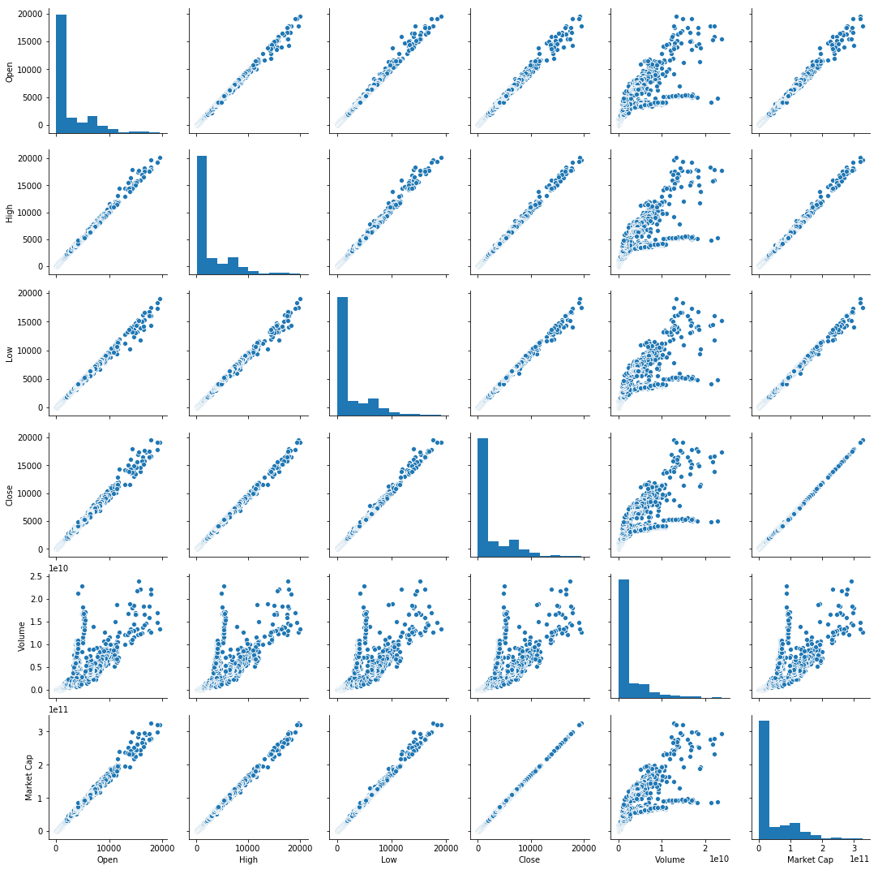
Pairplot of All Fields

Slide 5
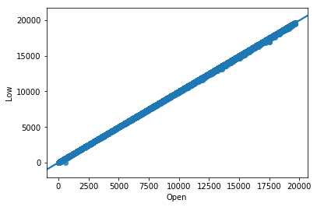
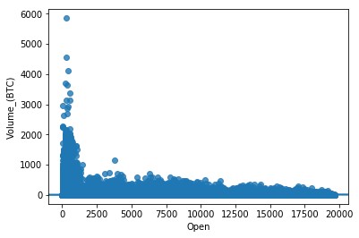
Correlation between features:
Open and Low Price Open and Volume

Slide 6
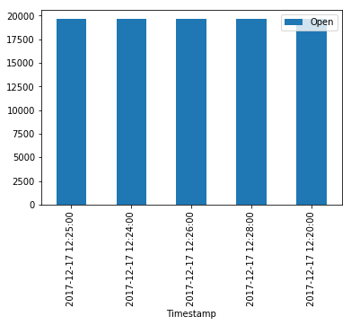

Top 5 opening prices Top 5 closing prices

Slide 7
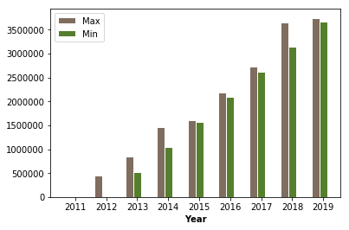
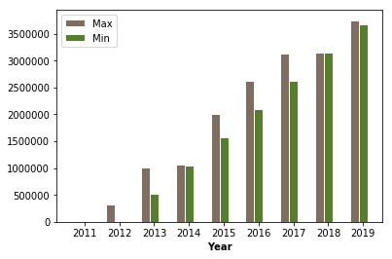
Year wise Analysis
Volume Price
Highest Variation 2018 Highest Variation 2018

Slide 8
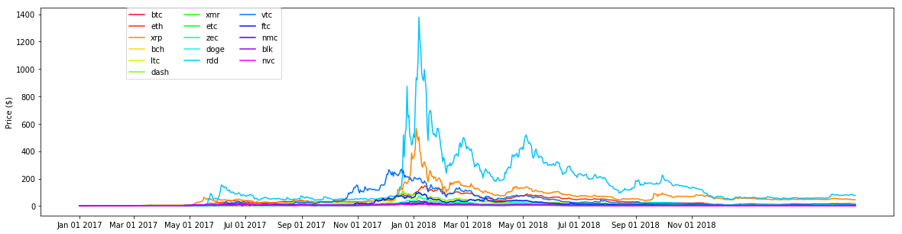
Data Analysis: Social Media Perspective
Fluctuation of various cryptocurrency price from Nov 2017 to Nov 2018

Slide 9
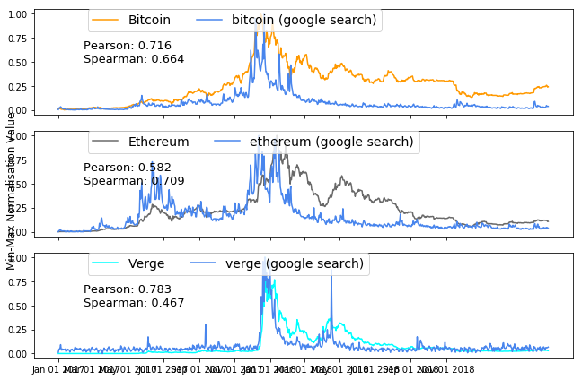
Data Analysis : Google Trends

Slide 10
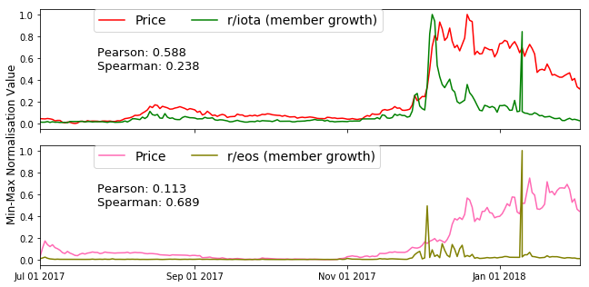
Data Analysis :Reddit Subscriber’s Growth

Slide 11

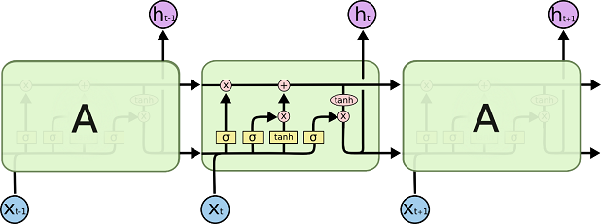
Neural Network for Bitcoin price prediction
RNN LSTM

Slide 12
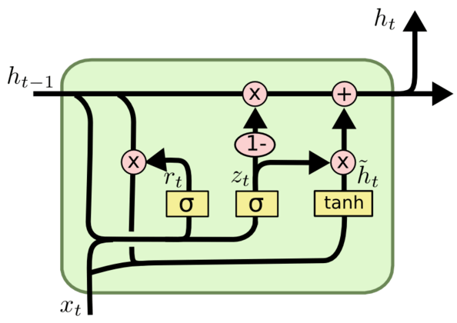
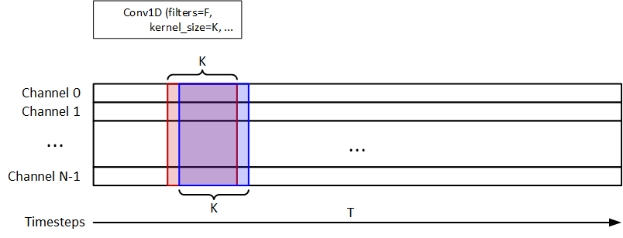
GRU CONV1D

Slide 13
Architecture
LSTM | GRU | CONV1D
LSTM - 32 units | GRU - 32 units | CONV1D - (64, 3)
Dropout - 0.2 | Dropout - 0.2 | MAXPOOL - 2
LSTM - 64 units | GRU - 64 units | LSTM - 100
Dropout - 0.2 | Dropout - 0.2 | Dropout - 0.2
LSTM - 128 | GRU - 128 | CONV1D - (32, 3)
Dropout - 0.5 | Dropout - 0.5 | MAXPOOL - 2
LSTM - 256 | GRU - 256 | Dropout - 0.2
Dropout - 0.5 | Dropout - 0.5 | Flatten
Dense | Dense | Dense

Slide 14
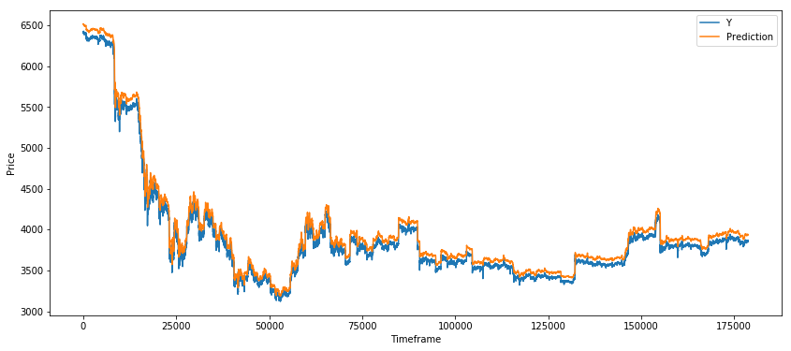
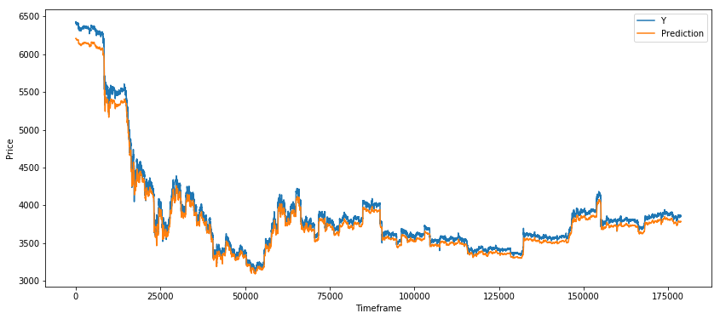
Performance
Prediction vs Actual
LSTM GRU

Slide 15

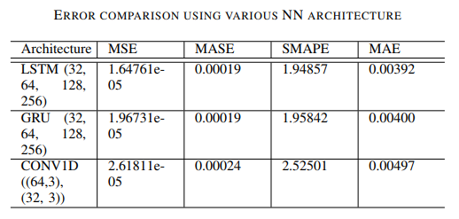
CONV1D

Slide 16
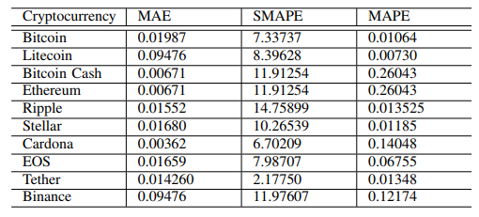
Errors on various cryptocurrencies

Slide 17
Using Tweets to improve prediction
Tweets of people help to get insight on the general trend following in market.
We use positive and negative sentiments on tweets in addition to Bitcoin price.
We used the sentiment of around 17.7 million tweets (in compressed form).
Features used:
Number of tweets
Positive sentiment tweets
Negative sentiment tweets
Closing price of stock
Architecture used is same as before.

Slide 18
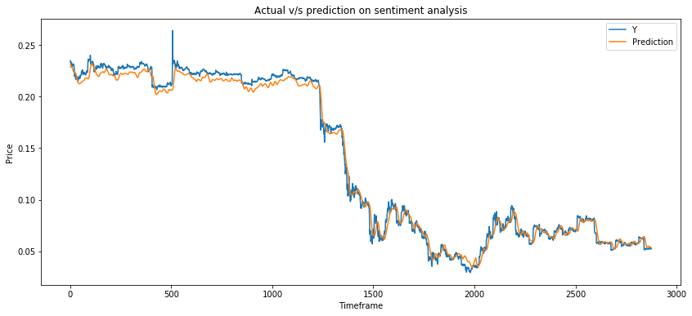
Prediction on training

Slide 19
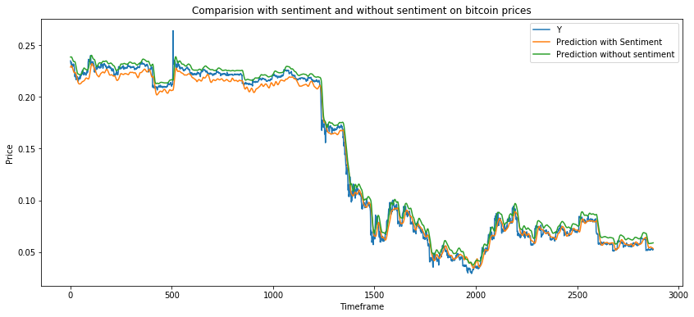
Comparison of Bitcoin Price with and without sentiment data

Slide 20
Other experiments
Giving weights to the prices with decreasing order of time (largest weight being the current) to make timeseries data for LSTM
This didn’t perform as expected.
The prediction were very poor. Reason for this was the change in price from the original price in past which resulted in inaccurate data to the model.
Model performs best when given data without any modification.
Training price prediction model solely on twitter sentiment data.
Training data solely on sentiment data didn’t work very well. The predictions were very poor.
It seemed necessary to include bitcoin prices to predict well.

Slide 21
Conclusion
We have applied GRU, LSTM, CONV1D to predict bitcoin price and the results were promising.
We have also incorporated sentiment analysis of twitter data to predict bitcoin price using LSTM neural network.
Future research should extend the proposed approach by considering additional parameters such as the political environment, human relations, and regulations, which vary across countries.

